Slide 1
Predicting promising locations for opening a bakery in Toronto

Slide 2
Population growth = Business growth But where should you build?
According to a 2019 study from Ryerson University, Toronto was the second fastest growing Metropolitan Area and the top growing city in all of the United States and Canada.
New business will be needed to support the growth in population
Location is a key consideration when opening a business and can determine its success or failure
K-Means clustering will help identify areas suitable for development

Slide 3
Data acquisition and cleaning
List of postal codes of Canada from Wikipedia:
‘Not assigned’ boroughs or neighborhoods were dropped
Latitude and Longitude of Canada postal codes from Cocl.us
Venue information including category and location were obtained from Foursquare.com
Postal codes and Latitude and Longitude datasets were combined to form a complete ‘picture’ of Toronto

Slide 4
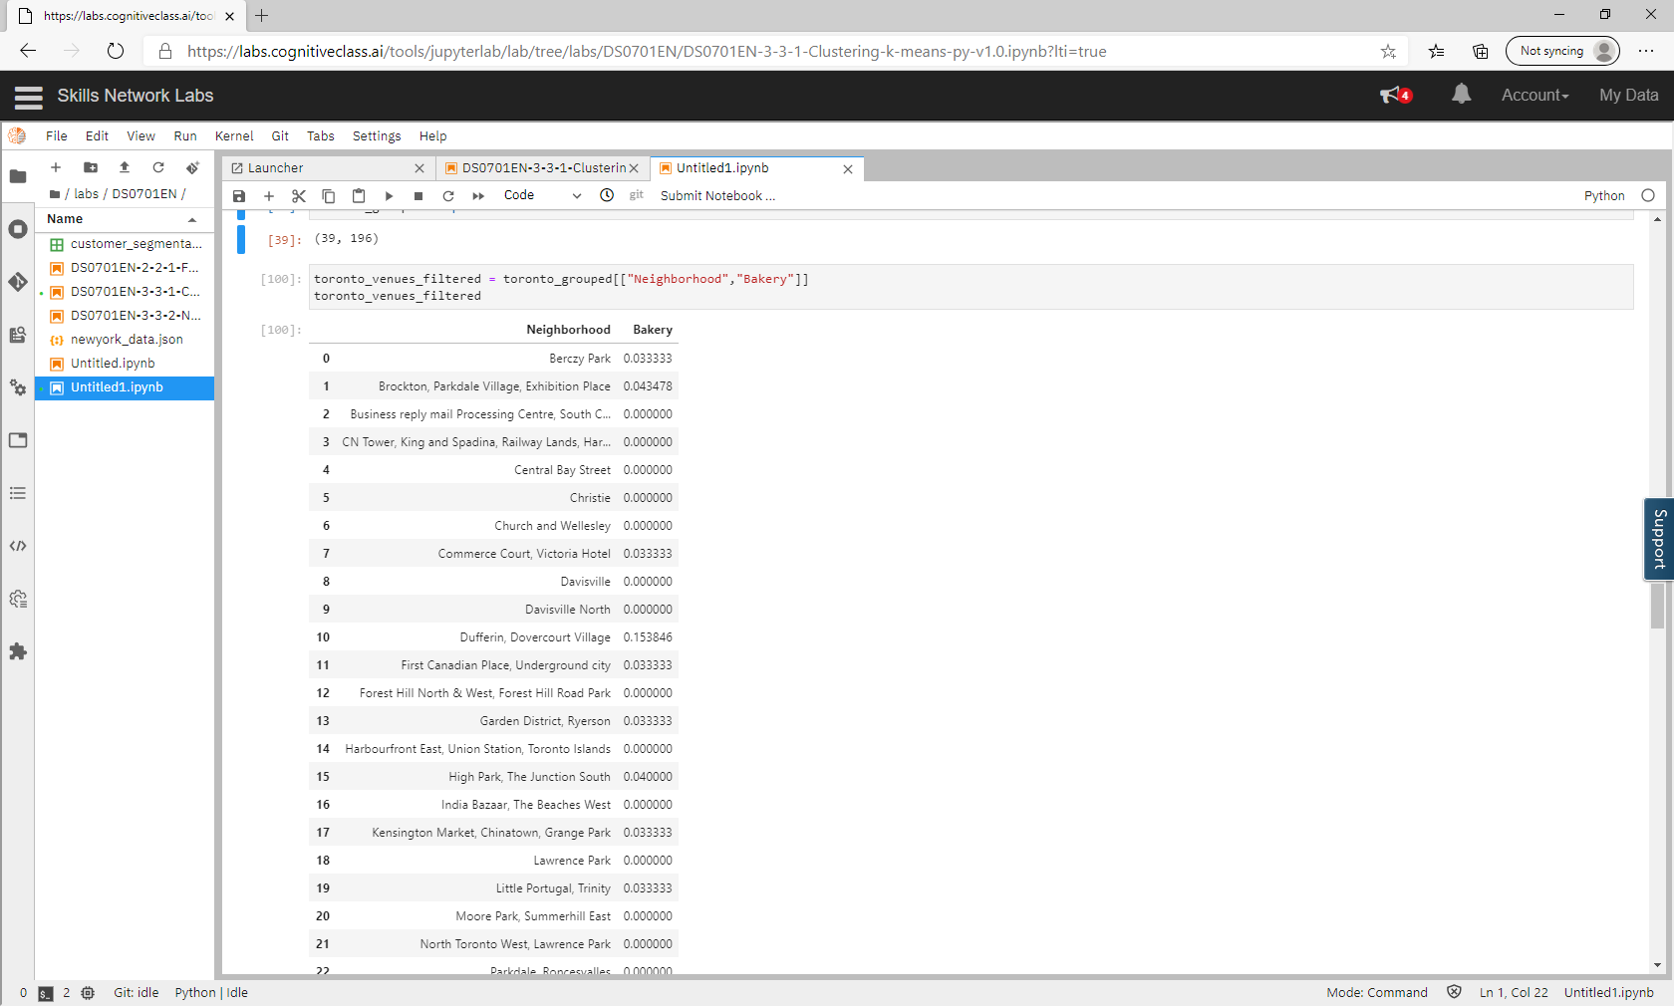
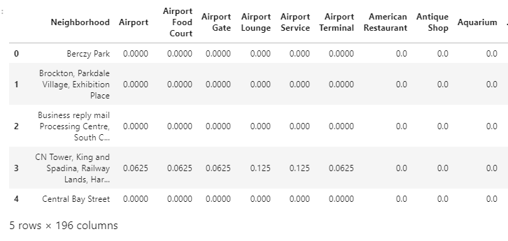
Foursquare Data – average occurrence of venue
The average occurrence of each venue was obtained was calculated for each neighborhood
Next, all businesses except bakeries were filtered out

Slide 5
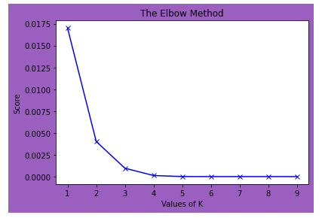
Elbow method
In order to determine the optimal amount of clusters, the Elbow method was deployed
Based on the ‘elbow’, we can see that the optimal number of clusters is 3

Slide 6
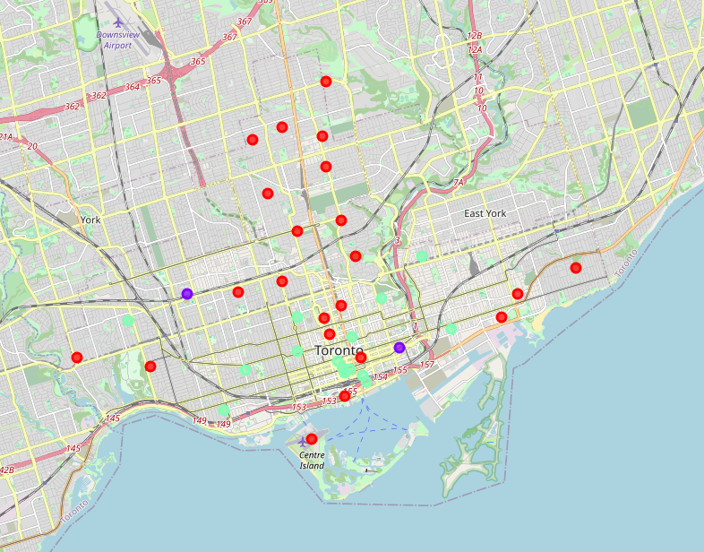
K-Means Clustering
Using K-Means clustering, clusters were assigned to our bakery data and a map was created displaying its results
1
Cluster 0 = Red
Top choice for new bakery location
3
Cluster 1 = Purple
Not recommended for new bakery location
2
Cluster 2 = Green

Slide 7
Recommendation and Conclusion
K-Means was used to help predict the optimal location for a new bakery
Cluster 0 has the least occurrences of bakeries among the clusters which makes it the best choice when considering locations for a new business
Cluster 1 had the most occurrences of bakeries and is not recommended for a new bakery location
This same model can be used to consider other business locations in Toronto, Canada
With a few modifications, it can also be used to evaluate other cities worldwide

